Slide 1




Validation
Simulations
04/08/21
Isabella Dula, Sarah Yun
Simulation Timeline and Objectives
O1: Create a robust and flexible model that can represent the dynamic electric fields in HOMES. The model should further validate results from other simulations and be open to changing various parameters to optimize in later steps.
Week: | Goal:
1 (Current status) | Researched methodology and identified key references; higher level code design; created documentation framework
2 | Define spatial-temporal domain, boundary conditions, initial conditions, physical parameters, and iteration structure; write out pseudocode and begin preliminary scripting; meet with an expert?
3 | Write out code; begin debugging and testing to meet O1
Next Steps: Talk to electronics team to determine which parameters are best to be considered for optimization. This could include modifying voltage, particle tracing, top plate thickness, electrode spacing, and electrode width

Slide 2
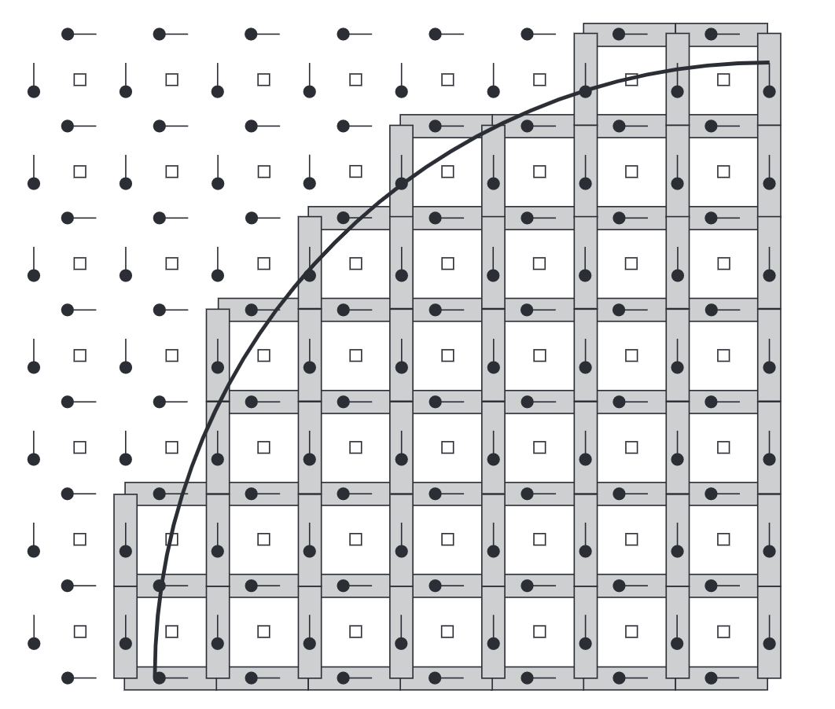
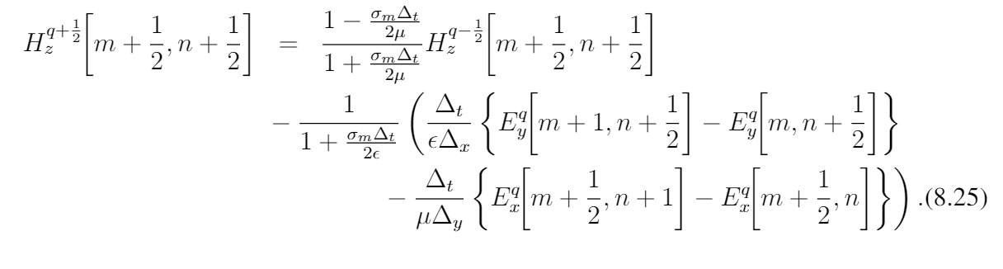
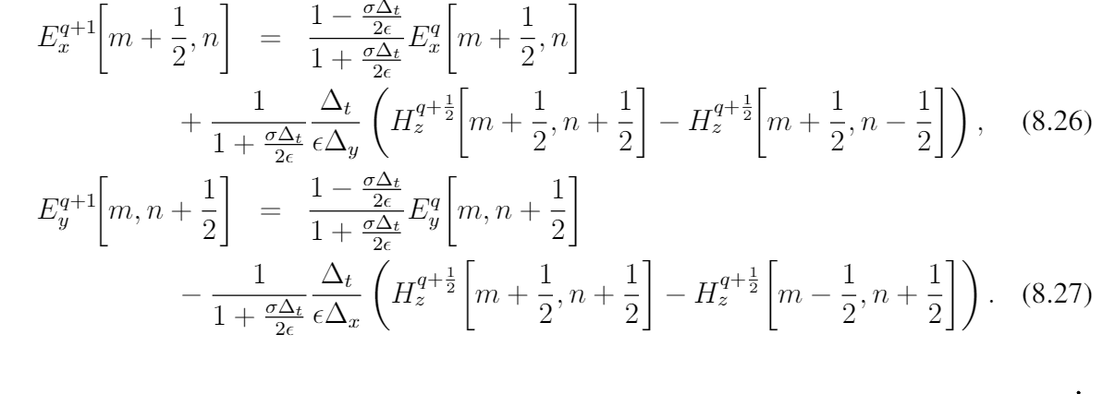

Validation
Simulations
04/08/21
Isabella Dula, Sarah Yun
Physics and the Finite Difference Time Domain Method
Physical domain
Boundary Conditions
Iteration Structure
-Define Parameters/structures: dx, dt, total dimensions, spatially-dependent properties
-Initialize electric field based on charge of electrodes
-for i in time domain
-Update time dependent state of electrodes
-Apply electrodynamic iteration equation:
-Reinforce boundary conditions
-end
-Data visualization
dt
dx
Electrodes modeled as perfect electrical conductors (E-field = 0)
Implement 2nd Order Absorbing Boundary Conditions at ‘edges’ of physical domain
$$c\frac{dt}{dx}=1$$
Many thanks to this resource: https://eecs.wsu.edu/~schneidj/ufdtd/

Slide 3
Validation
Simulations
04/08/21
Isabella Dula, Sarah Yun
Code
Considering either C or Python for the simulations
The book we referenced used C for FDTD simulations
Maybe C would have more flexibility since we can define our own data types with specific elements for each type?
However, Python may be easier to read, use, debug
Could represent physical aspects of HOMES in code as objects and give relevant attributes to the object
Ex) a node class with position, charge density, electric field, and etc as attributes
Represent the individual nodes on the grid
Already have some python code with various physical parts set up as classes
Create classes for various parts of HOMES
Represent grid as matrix
Array of arrays

